Slide 1
Arise Airlines
Presented by :
Rashi Bhargava(CSE)
Ravi Aggrawal(IT)
Saurabh Kumar Singh (CSE)
Simran Dhimaan(CSE)
Shantaanu Verma(CSE)
Guided by :
Ms.Deepa Basantani

Slide 2
ABSTRACT
This document presents a detailed explanation of the objectives, features, user interface and application of Flight Reservation System in real life. It will also describe how the system will perform and under which conditions it must operate. In this document it will be also shown user interface. Both the stakeholders and the developers of the system can benefit from this document.
The main purposes of this project are:-
• It is easy to use the product with all the information provided in the form of links.
• The user can access the portal with simple registration.
• Passengers can search flight , book tickets , check status , cancelation of tickets.
Admin can check status of passengers , flight details

Slide 3
PROJECT AND PRODUCT OVERVIEW
The main purpose of this software is to reduce the manual errors involved in the Airline Reservation Process and make it convenient for the customer to book the flights else when they require such that they can utilize this software to make reservation, modify reservations or cancel a particular reservation.
The name of the Software is “AIRLINE RESERVATION SYSTEM” .This software provides options for viewing different flights available with different timings for a particular date and provides customer with the facilities to book a ticket, modify or cancel a particular reservation but it does not provide the customers with the details of cost of the ticket and it does not allow the customer to modify a particular part of his reservation and he/she can modify all details.

Slide 4
Modules :
Module 1: Client
This module is responsible for maintaining the overall system based on defined business rules and it perform the following functions:
It can delete user.
It can modify the user details.
It can update website details.
Respond to e-mail request.
It can receive payments(online).
Module 2: Admin
Admin is responsible for the whole reservation system and its modification providing the necessary information.

Slide 5
Flight Reservation -Existing System
… “goibibo.com, “yatraa.com”, etc . brought the revolution of
transforming traditional way of flight reservation into technological
advancement called “Online Flight Reservation Portal”.
… Initially, less number of trusted clients and improvement through
advertisements and branding.
Demerits :
1. No value for money services.
2. Increased unwanted duplication in Flight Reservation.
3. Absence of SMS Module.
4. Lack of preferred advance search option.
5. Increased Spam mails.

Slide 6
SOFTWARE REQUIREMENT
Tomcat Server
Editor :Notepad++
HTML 5
CSS 3
Bootstrap 4
JEE
MySql (Backend)

Slide 7
APPLICATION
Can be used widely by Passenger to find suitable flight.
Can be accessible on Tabs and PDA’s.
The technology, the proposed system is highly user-friendly.
The application allows users to search for available flights, choose flights, and book flights.

Slide 8
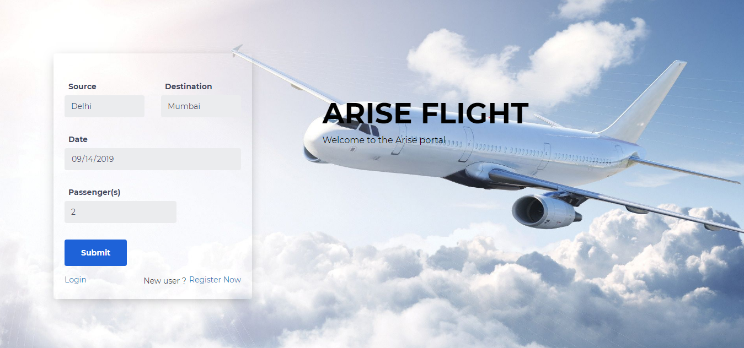
HOME Page

Slide 9
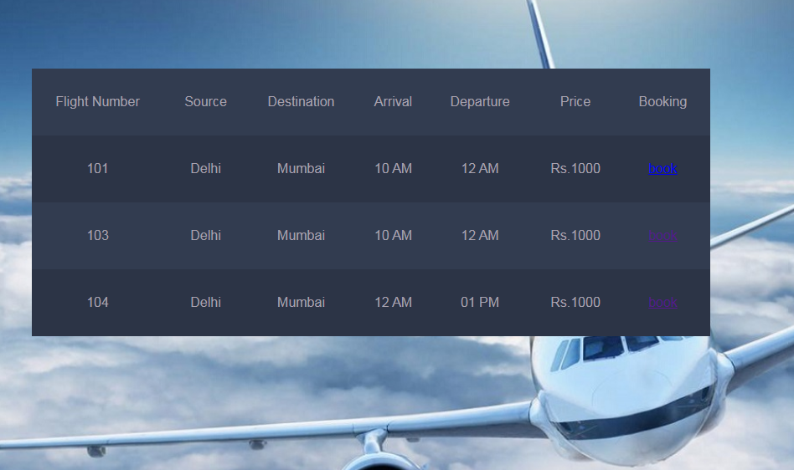
FLIGHT DETAILS

Slide 10
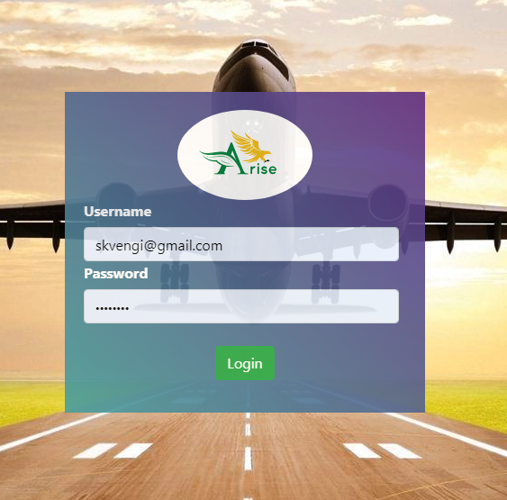
LOGIN

Slide 11
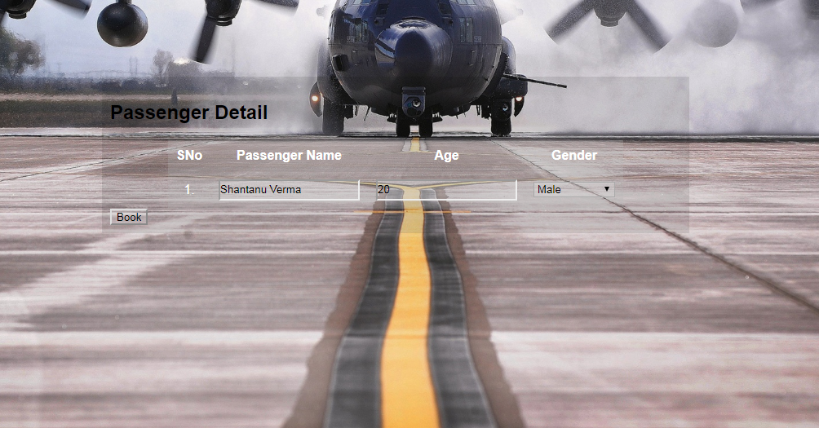
PASSENGER DETAILS

Slide 12
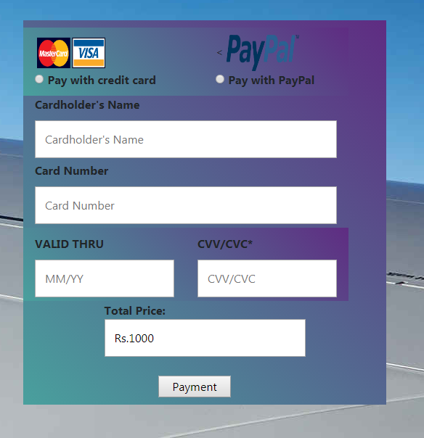
PAYMENT

Slide 13
CONCLUSION
The entire project has been developed and deployed as per the requirements stated by the user , it is found to be bug free as per the testing standards that are implemented. And by specification-untraced errors concentrated in the coming various, which are planned to be developed in near future.
Finally, we like to conclude that we put all are effort throughout the development of our project and try to fulfill most of the requirements of users.

Slide 14
THANK YOU

